Slide 1
IBM Data Science Capstone Project – Melbourne Housing Analysis

Slide 2

Problem Statement
Moving Suburb to work in North Melbourne
Want to be close to Parks and Restaurants
Would like to live near work
Would like to be on lower price range

Slide 3
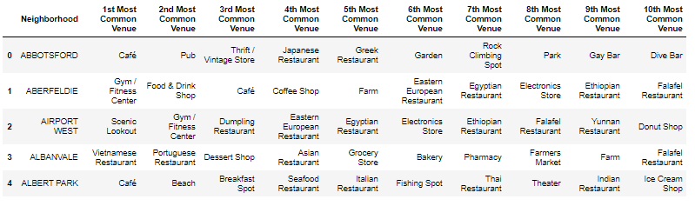
Data Selection
1. Price data from median price sale for past 2 years
2. location data for all suburbs in Melbourne
3. Venue data outlining all venues in each suburb

Slide 4
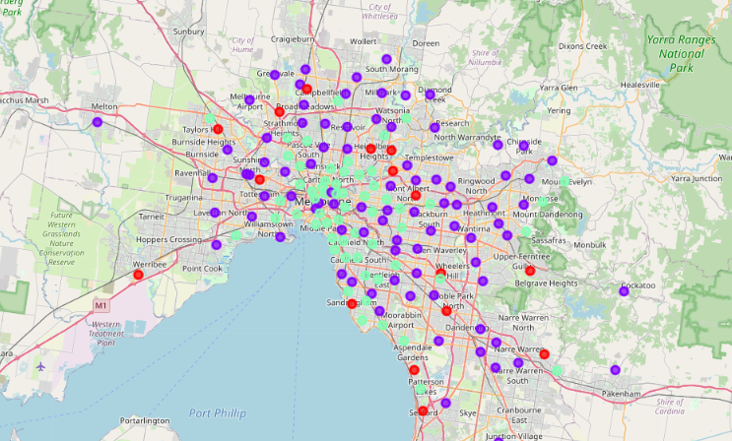
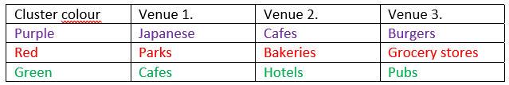
Initial analysis
Locations were graphed on geo map and the venue data was clustered to reveal similar Suburbs by venue popularity

Slide 5
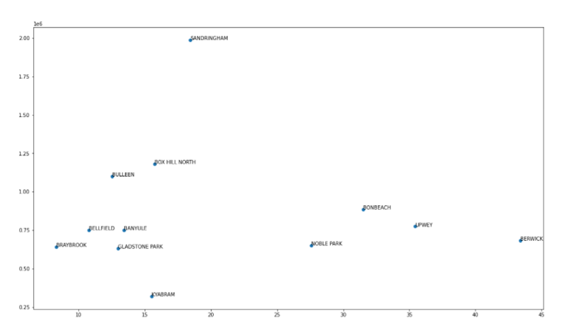
Suburb Narrowing
Given the venue results, RED was selected as the cluster of interest
Next analysis of distance and price is required

Slide 6
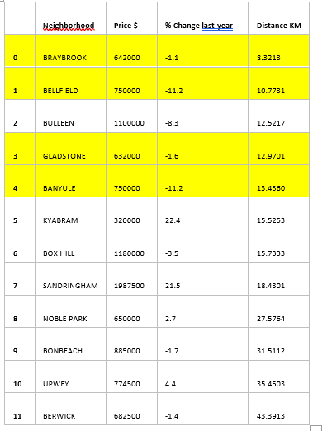
Final results
From scatter plot 4 suburbs are selected as the best possible for the client
Reasonable pricing, close to parks and low distance to North Melbourne

